Slide 1





RPI Dashboard
Group 6: Aoyan, Andrew, Gabriel

Slide 2
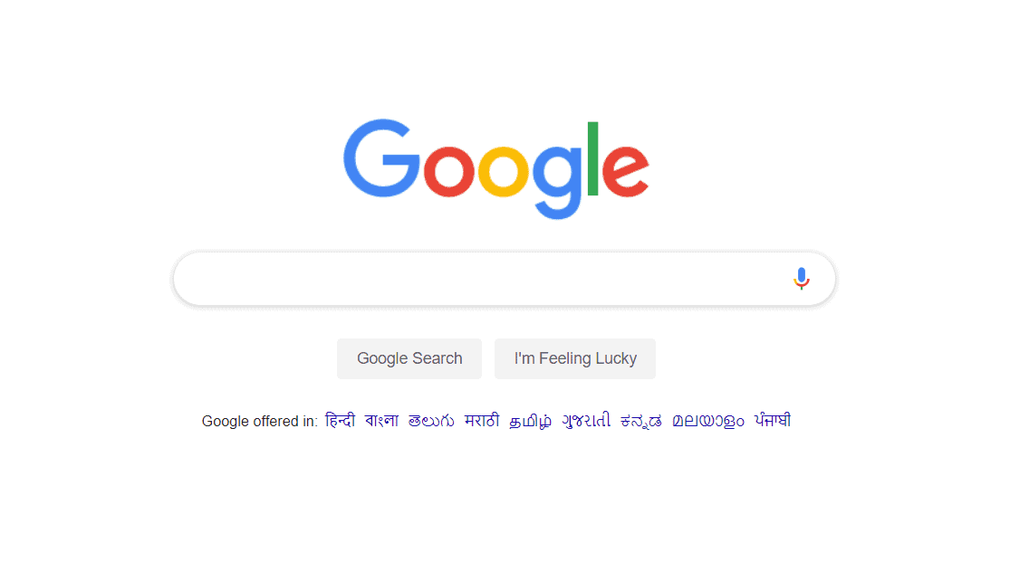
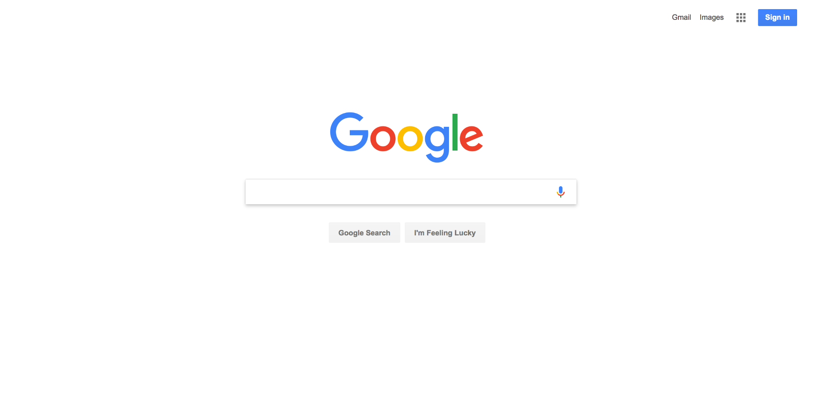

Slide 3

Problem & Solution
How can we improve on something we use everyday?
Notes:
there is unutilized potential in the utility of the browsers landing page for students

Slide 4
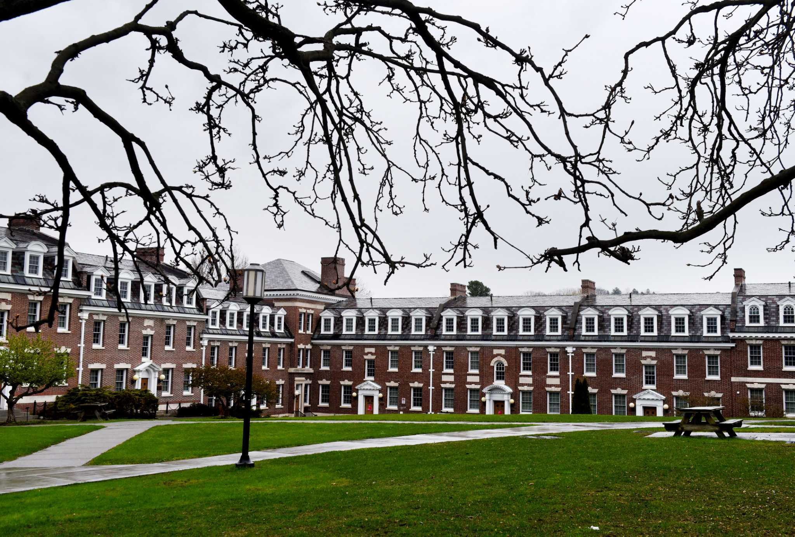

RPI Dashboard
We designed RPI dashboard to offer an improved browsing experience geared towards RPI students
Notes:
We designed RPI dashboard to function as an improved landing page for the google search engine with specific utility geared towards rpi students

Slide 5



Features
Built in schedule tracking
QuACS/SIS integration
Real time weather report
Bookmark organization
Google search integration
Notes:
Looking more specifically at what these utilities are
We designed a dynamic schedule tracking and alert system that would display when students lectures are, including which are occurring on the current day
And send alerts when the lecture is occurring soon
This is accomplished through quacs and SIS integration which allows students to match their current rpi schedule with the dashboard
Given the volatility of Troy weather, we also included a real time weather report so students can more effectively prepare for the weather outside
And in order to make this dashboard an improvement on the current google search engines, we had to maintain general functionality of google search, which includes bookmark organization, as well as actual google search engine access

Slide 6



Focus Areas

Slide 7
Personas

Slide 8
Persona 1 - John Doe
Struggles with punctuality
Built their schedule in Quacs
Added the CRN numbers to the site
Receives notifications before lecture starts

Slide 9
Persona 2 - Jane Doe
Attends early lectures
Has little time to get ready
Struggles to pick out clothes quickly
Utilizes weather report to coordinate their outfits efficiently

Slide 10
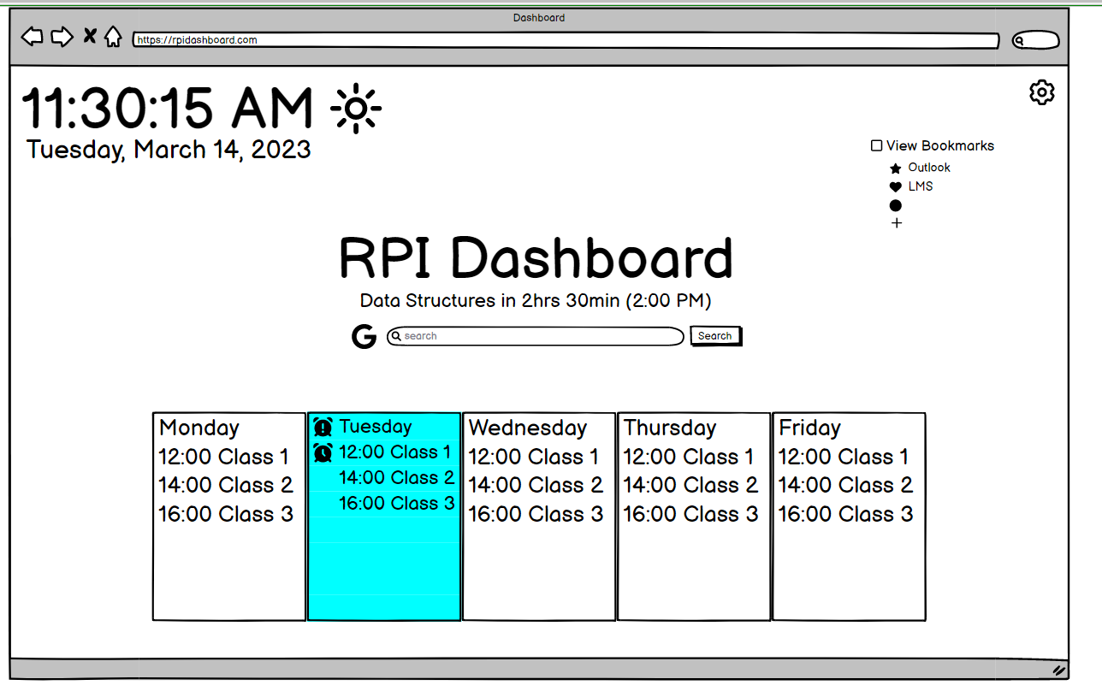
Balsamiq Design

Slide 11
Implementing the design
Integrate weather API
Dynamically display weather conditions
Process CRN numbers
Save settings, bookmarks, and calendar locally
Form that searches Google

Slide 12
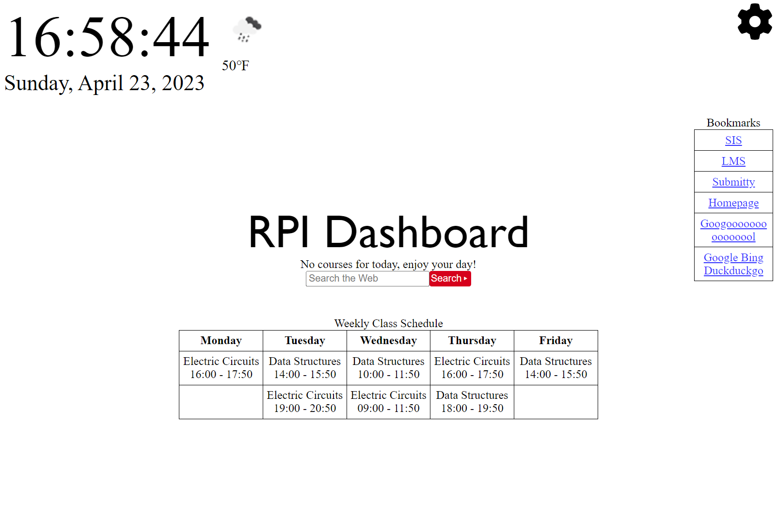
Final Product

Slide 13

Next Steps
Improve background color changes to be more dynamic
Add more bookmarks that come with the dashboard
More calendar customization
Add events, tasks, cancellations

Slide 14
Questions?

Slide 15








Extra resources

Slide 16
SlidesCarnival icons are editable shapes. This means that you can:
Resize them without losing quality.
Change fill color and opacity.
Change line color, width and style.
Isn’t that nice? :) Examples:
Find more icons at slidescarnival.com/extra-free-resources-icons-and-maps

